Slide 1
Sterling Entrepreneur Help
Section 4: Three Collaborative Resources

Slide 2
Three Collaborative Resources
SterlingCareerHelp.com can help you be self-reliant for life by helping with networking, research, interviewing, negotiating, and organizing your data
for life.

Slide 3
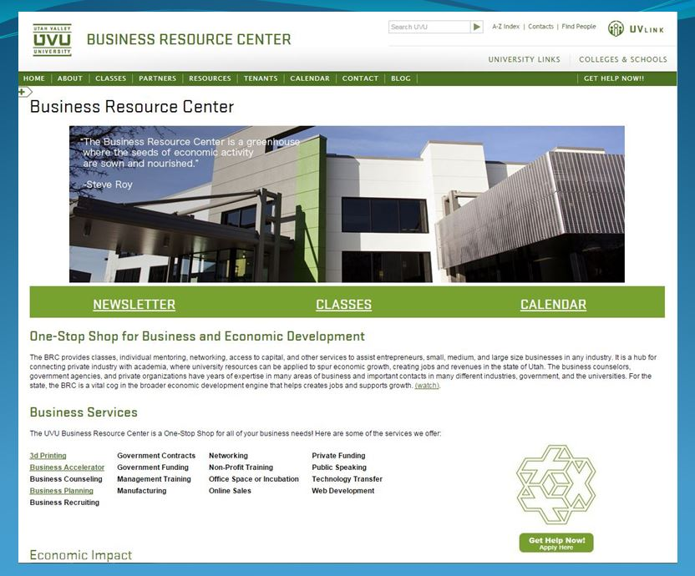
Three Collaborative Resources
2. Business Resource Centers (example at uvu.edu/brc) can help with Business Accelerator, counseling, planning government contracts, and many other business functions.

Slide 4
Three Collaborative Resources
3. SCORE.org can help with mentoring, marketing, management, how to start a business, and how to run and grow a business.

