Slide 1

Sterling
Entrepreneur Help
Section 1: Lean Canvas
Section 2: Business Model Canvas
Section 3: Business Model Canvas Resources
Section 4: Four Collaborative Resources

Slide 2
Purpose
Help others become entrepreneur-self-reliant
for life.

Slide 3
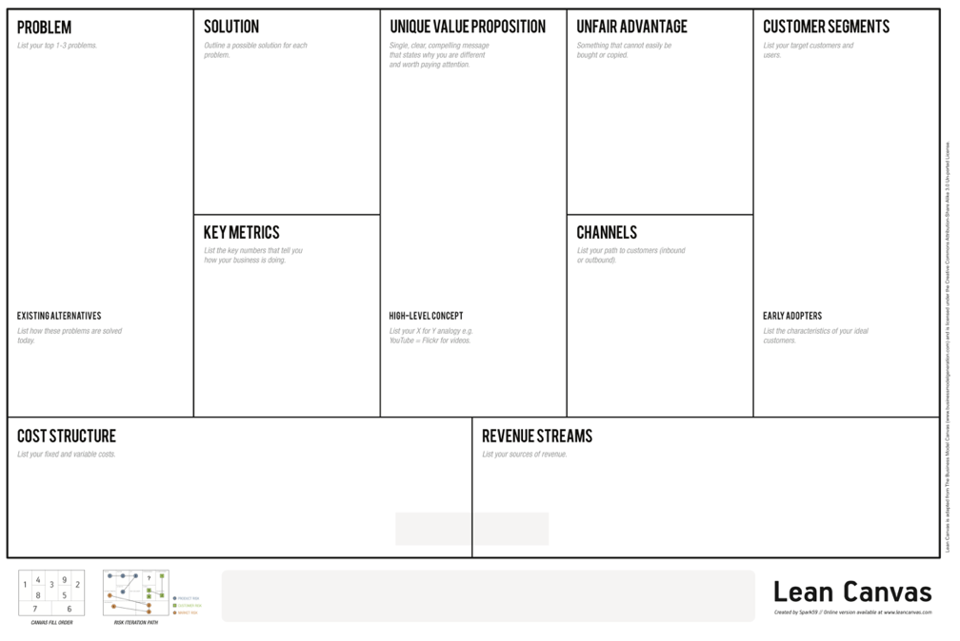
The Lean Canvas
1
4
3
9
2
1d
8
5
7
6

Slide 4
The Lean Canvas
1. Problem: This is not your problem but the problem of your customer segment that you solve.
1
1

Slide 5

The Lean Canvas
2. Customer Segments: Customer segments are not the whole world. You need to target your customer segments. Use a new canvas for each customer segment you identify.
2

Slide 6
The Lean Canvas
3. Unique Value Proposition: A unique value proposition is what makes you stand out, your compelling message, why you are different.
3

Slide 7
The Lean Canvas
4. Solution: Define your solution once you have found it. Have your solution start out as a Minimum Viable Product (see book and Web site on the last slide of this presentation).
4

Slide 8
The Lean Canvas
5. Channels: Your channel is the way your customer segment finds and knows who you are and the way you deliver your product or service.
5

Slide 9
The Lean Canvas
6. Revenue Streams: Get to know your Revenue Model, Lifetime Value, Revenue, and Gross Margin (see book and Web site).
6

Slide 10
The Lean Canvas
7. Cost Structure: Learn about Customer Acquisition Costs, Distribution Costs, and Hosting (see book and Web site).
7

Slide 11
The Lean Canvas
8. Key Metrics: List the Key Numbers (see book and Web site) that tell you how your business
is doing.
8

Slide 12
The Lean Canvas
9. Unfair or Competitive Advantage: A competitive advantage is something you offer that cannot easily be copied (see book and Web site).
9

Slide 13
The Lean Canvas
All nine fields in The Lean Canvas are assumptions until you get out of the building and validate them (see book and Web site below).
For the big picture on The Lean Canvas, read Running Lean by Ash Maurya and see http://leanstack.com/
If you have good results, progress to The Business Model Canvas.

