Slide 1
HOW I STAY
CAREER SELF-RELIANT FOR LIFE
Beginning of Section 4
of Four Parts

Slide 2
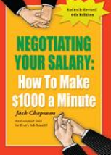
Negotiating
When do you negotiate?
1. After you have received an offer
on the position
2. At yearly reviews
How do you negotiate? Read Jack Chapman’s
Negotiating Your Salary:
How to Make $1000 a Minute

Slide 3

Getting Off to a Good Start in Your Career
• Find a good mentor within
the company.
• Never stop networking.
• Never burn bridges!
• Get skilled help with résumés
and thank-you letters.
• Take a suggestion only when you understand its benefits.

Slide 4
Organize Your Career for Life
Keep track online of networking contacts, targeted companies, résumés, thank-you letters, etc.
Find the program for organizing contacts that works best for you. Some examples are
Outlook Gmail Excel
Monster LinkedIn Headhunters
Facebook MySpace Jibberjobber.com

Slide 5

A Good Career-Organizing Program Should Help You …
Organize Your
• Track prospective employers, recruiters, and job boards.
• Track each career posting that you apply for.
• Log communications with each company you contact.
• Set action items to ensure appropriate follow-up.
• Know initial contact dates, the date you sent your
résumé, last action date, next action date, etc.
• Associate important documents, such as your
résumé, with each career posting.
Job Search

Slide 6
A Good Career-Organizing Program Should Help You…
Organize Your
• Rank the relationship of each person in your network.
• Categorize and tag each person to create sub-networks for easy
searching.
• Define degrees of separation for each person to measure effectiveness.
Example: You met Steve, who knows Mary, who knows
Joe, who knows of an opening for your dream job.
• Track contact information and important dates.
• Log any communications.
• Store notes on what you can give each person and what they can give
you.
• Store important career-search documents online.
• Prepare for interviews with your own interview preparation worksheets.
Network

Slide 7
JibberJobber.com
JibberJobber.com keeps track of networking contacts, targeted companies, résumés, thank-you letters, etc.
JibberJobber.com has a free toolset for the serious career seeker. It can help you become career self-reliant for life.

Slide 8
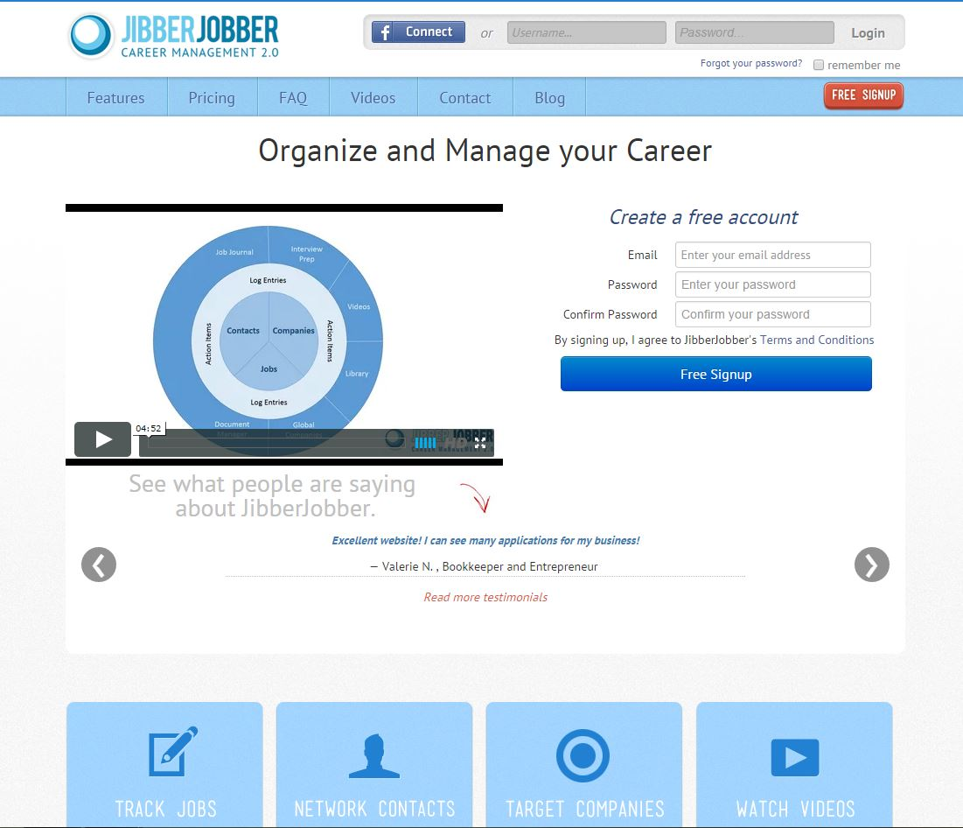

Slide 9
  Knowledge is nice, but …
  knowledge does you no good until you organize it (use jibberjobber.com)
  and you apply it!

Slide 10
Just the Beginning …
The End
End of Section 4 of Four Parts

