Slide 1
HOW I GET HELP
FROM OTHERS
Beginning of Section 3
of Four Parts

Slide 2
Where People Look for Careers
Where People Time People Spend in Where Jobs
Look for Work Each Type of Search Are Found
Want Ads and Internet 65% Less than 5%
Agencies 27% 10−20%
Approaching Companies 5% 15%
Networking 5% 60−90%

Slide 3
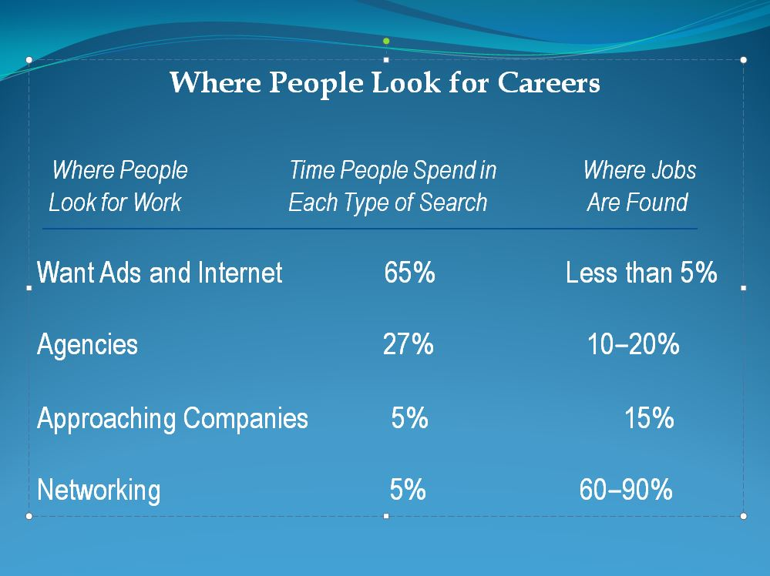
Want Ads and the Internet
For want ads, use one Sunday paper a week.
Use the Internet as a research tool.
Agencies and Executive Recruiters
Work with as many agencies as you want.
If you want to work with executive recruiters, read Bill Humbert’s book
RecruiterGuy’s Guide to Finding a Job.
Remember that the executive recruiters don’t work for you. They are paid by the recruiting companies. They cannot legally float your résumé.

Slide 4
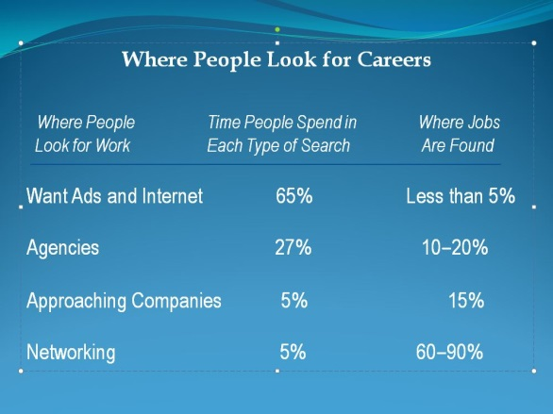
Where People Look for Careers, cont.
Approaching Companies
People Who Know about a Position:
Golf Buddies The Board Entire Company Public Advertising
----------------------------------------------------------------------------------------
2 People 12 People 300 People The Whole World (Always network into career positions before the whole world knows about it!)
Networking
When you plan your week, how will the figures in
“Where People Look for Careers” affect your plan?
Networking is 60−90% of where careers are found!

Slide 5

Three Steps of a Career Search
First, in your career search, look at industries.
What industries are dying?
What industries are growing?
Second, once you have selected industries, you need to target companies.
To help yourself do that, read Good to Great, by Jim Collins.
Third, now that you have targeted your companies, you need to network into those companies.

Slide 6
Create a 30-Second Summary
for Networking
Give your name.
Give a general introduction with
  a skill or trait you have,
  an example of a time you have used
  the skill or trait, and the results of that example.
State your education and/or your work experience.
Say, “I’m looking at industries A, B, and C. I am targeting companies
such as these 5 companies: [name companies]. Who do you know
who might help me with these industries and companies?”
5. Restate your name.

Slide 7
Networking
Tips for Networking
1. Know why you are
networking (see, for
example, number 4,
previous slide).
2. Learn something from each contact. Ask for
information and ideas.
3. Get more than one referral from each contact, one
referral at a time.
4. Say, “I’m looking at industries A, B, and C.
I am targeting companies such as these five
companies: [name companies]. Who do
you know who might help me with these
industries and companies?”

Slide 8
Informational Interviewing
You should break your 20-minute interviews into 4 parts:
• First 5 minutes: Talk with your interviewees about
themselves and their families.
• Second 5 minutes: Talk about the industries and your
targeted companies.
• Third 5 minutes: Talk about yourself and your skills.
• Fourth 5 minutes: Get two referrals before you leave.
At the end of a 20-minute informational interview, stand
up and say, “My 20 minutes are over.”
Remember to send a thank-you note!

Slide 9

How to Make Powerful Impressions with People You Contact
45% Packaging
35% Responsiveness
Power Answers
30-Second Summaries
“Once . . . and Now”
10% Experience
10% Other Factors

Slide 10
Research, Research, Research
Research the marketplace to understand
• industry gaps, problems, and trends.
• company gaps, problems, and trends.
Understanding industry and company gaps, problems, and trends can help you with your next career. To do that:
Read newspaper articles, trade and association journals and magazines, and other publications.
2. Search the Internet, including Google©. The library also has valuable databases you can use at no cost.
Network to find direct contacts with people who do business with specific industries and companies.

Slide 11

Get on the Radar Screen
What does it mean to get on the
radar screen in your career search?
Make yourself known!
What can you do to get on the radar screen for a
specific targeted company or within a specific industry?
1. Join and interact with professional associations and community
service groups.
2. Get companies to know you through informational interviews.
3. Get published in an industry-related journal or association newsletter.
4. Attend at least one meeting of a networking group each week.
Q. How can attending at least one meeting of a networking
group each week help you stay on the radar screen?
A. When you go to the network meeting, people will know who you are.
By using “abundance mentality,” people will help you.

Slide 12

The “Abundance Mentality”
Stephen R. Covey’s term “abundance mentality”
(Helping others helps you
get what you want)
The Seven Habits of Highly Effective People
by Stephen R. Covey

Slide 13
Two groups that can help you:
UVU Business Resource Center
https://www.uvu.edu/brc/
SCORE
https://www.score.org/

Slide 14
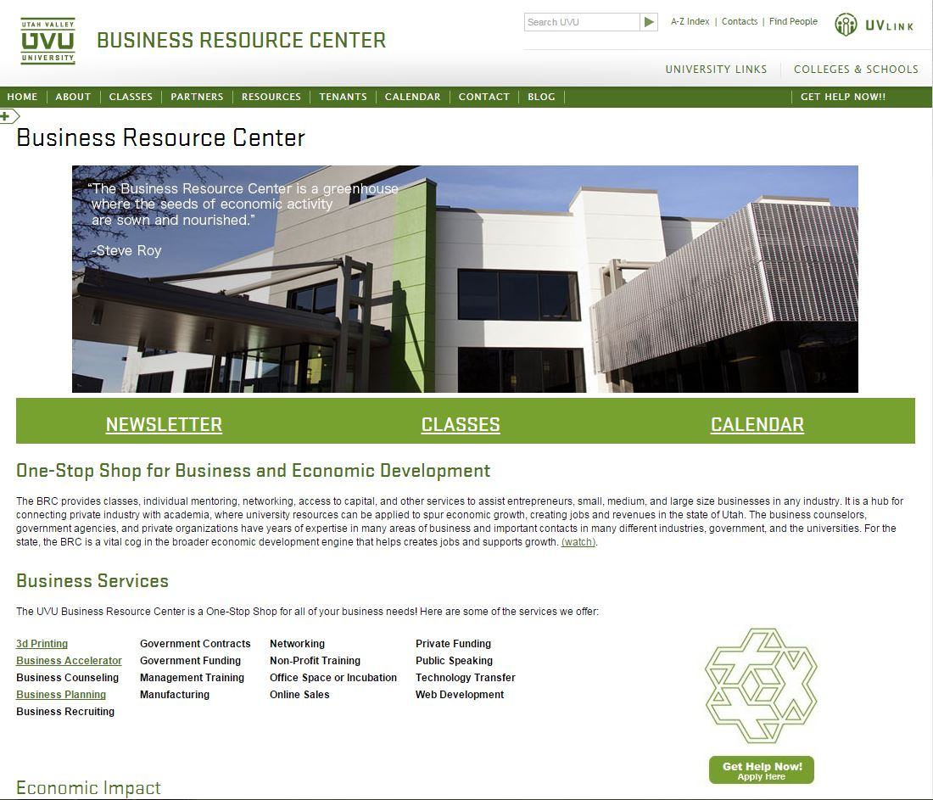

Slide 15


