Slide 1
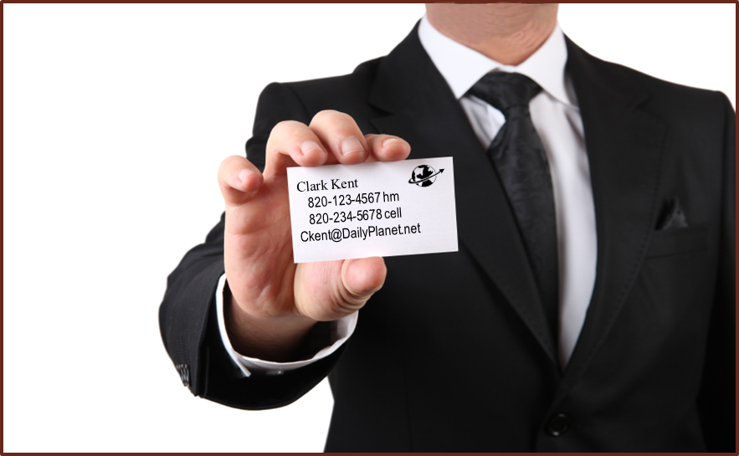
HOW I COMMUNICATE WHO I AM
Beginning of Section 2 of Four Parts

Slide 2

Your Career Search
Transferring Skills
“You can change both your occupation
and your field at the same time, or you can change them one at a time.”*
Management
Furniture / Home Furnishings
Sales
Furniture / Home Furnishings
Sales
Homes
Occupation
Field
* Richard Bolles, What Color Is Your Parachute?

Slide 3

Building Blocks for Your Career for Life
List several positive words that describe you.
List several accomplishments.
List several previous achievements in your
employment and education.
Building blocks will help you with
interviews, personal branding,
networking, and annual reviews.

Slide 4
Examples of Interview Questions to Prepare to Answer
This is a list of common interview questions for which you should have prepared answers. The key to interviewing success is simply being prepared for the questions and having a mental outline to follow in responding to each. Do not memorize your answers. Employers want to know how you can save them money, make them money, or solve their problems. Convey this information by using techniques you have learned.
  1. What have you done that shows your initiative?
  2. Describe your leadership style.
  3. Do you feel your experience qualifies you for this position?
  4. What have you liked best about your most current company?
  5. What do you hope to be doing in five years?
  6. What is your greatest weakness?
  7. Explain your role as a team leader, team member, and team player.
  8. How do you measure success?
  9. What have you learned from the jobs you have held?
  10. Do you prefer working alone or with others?
  11. I’ve interviewed people with more experience than you. Why should I hire you?
  12. How do you resolve conflict?
  13. How has your management style changed over the years?
  14. How do you cope with organizational change?
  15. What makes you effective in large groups?
  16. Describe the ideal boss.
  17. Cite an example where you have been a good communicator.
  18. How might you improve your communication skills?
  19. What have your experiences been with terminating or removing subordinates?
  20. What career experience has been valuable to you?
  21. What causes you to be impatient with others?
  22. When your boss—or the project—puts extreme pressure on you, how do you usually respond?
  23. How do you evaluate the performance of a subordinate?
  24. How would this job meet your long-range and short-range goals?
  25. How would your last boss describe you?
?

Slide 6
How to Give Power Answers
Skills and Traits Achievement Results
“I am a Example of Took gross
self-starter!” serving clients sales from
as independent $450,000 to
furniture rep $1,200,000
the first year
“I have Example of Sold couple’s
determination!” home with bullet old home and
holes and the sold a home to
“War of the Roses” former wife
“I can Example of Sales gain of
persuade!” J.C. Penney 125% first year
retail furniture and an additional
department 50% second year

Slide 7
      Create a 30-Second
      Summary for Interviewing
Give a general introduction with a hook; for example, “I get things
done.” Follow with a power answer.
2. State your number of years of education and professional
experience.
3. Use three power answers if you can keep within 30 seconds; use
fewer power answers if you cannot.
4. Summarize by showing how you can help the company. One
example might be, “You need four skills and I have those skills;
therefore, we should be a good match.”

Slide 8

“Once . . . and Now . . .”
You are not in an interview to
tell your interviewers all your
potential weaknesses.
• Always be honest, but use favorable words to
describe your past.
• Use “Once . . . and now . . .” to answer questions
that should be answered with a negative-to-positive
statement. An example would be “Once I tried to do
it all, but now I have learned to delegate.”

Slide 9
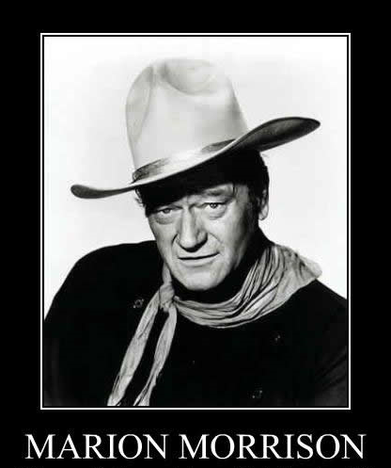
Personal Branding
Why should you define yourself?
Either you let others define you
OR
You define yourself!
Example 1:
Marion Morrison vs. John Wayne
(Given Name) (Stage Name)

Slide 10


Personal Branding
Why should you define yourself?
Either you let others define you
or
You define yourself!
Example 2:
Lido Iaccoca vs. Lee Iaccoca
Lee Iacocca’s brand-defining accomplishments:
1. Project manager for Mustang
2. Saved Chrysler Motors
Lee Iaccoca controlled his
professional brand from the beginning of his business career.
Power answers, the 30-second summary, and turning negatives to positives apply to personal branding.
Get book by William Arruda and Kirsten Dixon:
Career Distinction: Stand Out by Building Your Brand

Slide 11
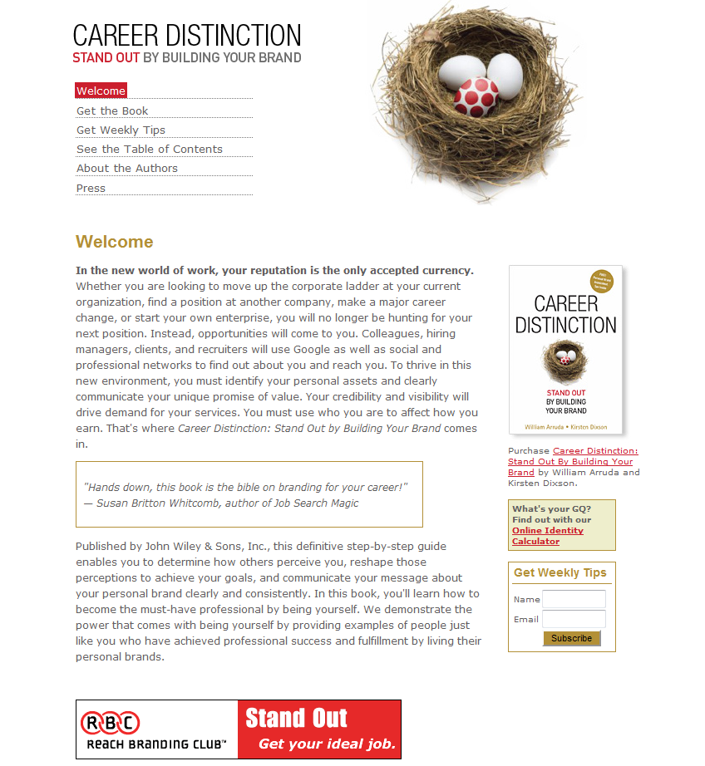

Slide 12
Order of the Interview
(The interviewer controls questions 1–5; the interviewee controls 6–7.)
1. What you do from the knock on the door to when you’re seated in the chair
2. The first question: “Tell me about yourself.” (30-Second Summary)
3. The second question: “What’s your greatest weakness?”
Negative to Positive: “Once . . . and now . . .”
4. The third question: “How do you measure success?”
Power Answer
5. “Do you have any questions for me?”
(Always have questions for the interviewer.)
6. Indicate that you want the position (only if you do).
7. Follow up: “When will you make the decision on this position?” Interviewer
will answer, “Monday.” Interviewee will then ask, “Can I get back to you
Tuesday or Wednesday?” If the answer is yes, ask, “Would Tuesday or
Wednesday be better?”

Slide 13
It’s not the will to win but the will to prepare to win that separates those who wish and dream from those who make it happen!

