Slide 1
Sterling Career Help
Learn to…
Network: Learn how to network online and in person.
Research: Understand gaps, problems, and trends.
Interview: Learn four steps for interviewing.
Negotiate: Learn when and how to negotiate.
Organize: Organize your networking leads with a system.

Slide 2
Purpose
Help others become
career self-reliant for life.

Slide 3
Ways to Generate Income
Employment
Self-employment
Employment while building your business
This presentation of Sterling Career Help focuses on employment.

Slide 4
Overview of the Four Sections
Section 1 - Who You Are
Section 2 – How You Communicate Who You Are
Section 3 – How You Get Help from Others
Section 4 – How You Stay Career Self-Reliant for Life

Slide 5
Who You Are
Beginning of Section 1 of Four Parts
How You Confirm or
Discover Who You Are

Slide 6
A site to help you find a good career fit
https://www.utahfutures.org

Slide 7
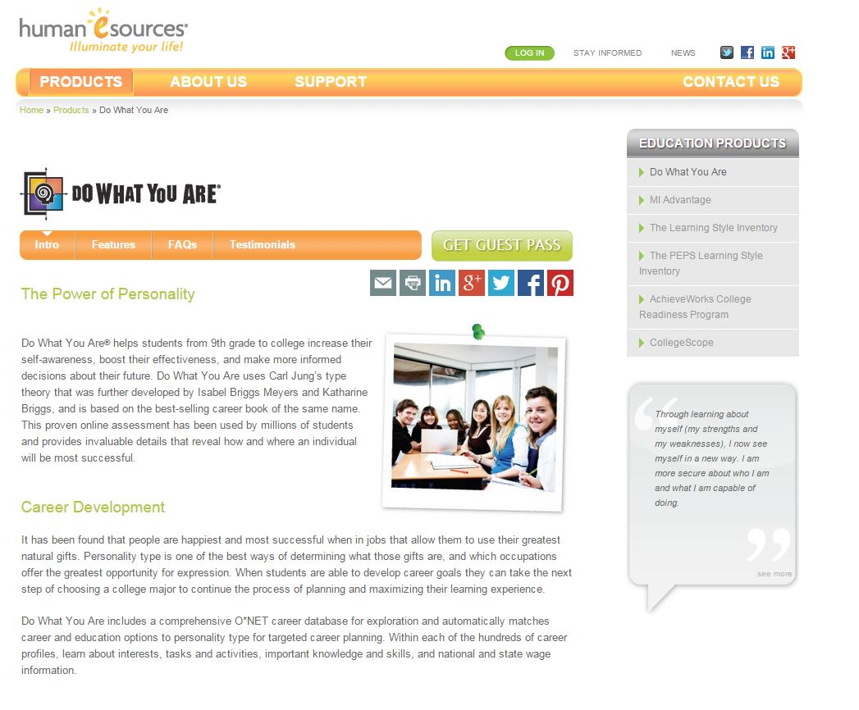
This book helps you match personality with career.
https://www.humanesources.com/organizations/programs/dwya

Slide 8
A book to help you work from your strengths
Strengths.gallup.com/110440/
About-StrengthsFinder-20.aspx

Slide 9
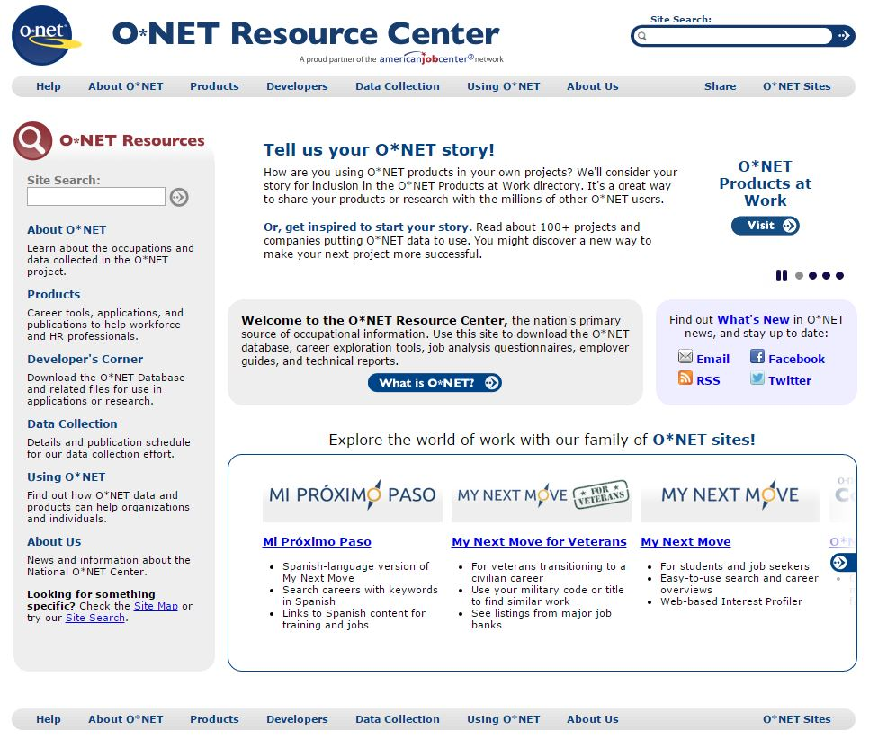
A good site to help you find growing industries
www.onetcenter.org

